Slide 1


For Beginner
By :- RAHUL JOGRANA
www.dotnetlab.in
Twitter:- @thejograna
Github:- github.com/rahuljograna

Slide 2
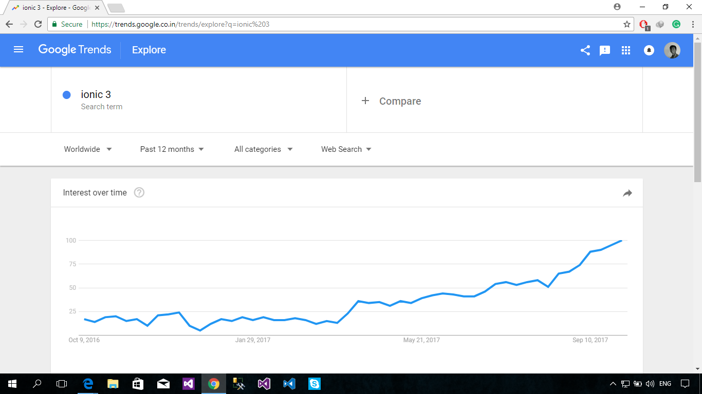

Slide 3

Content
What is ionic
Whys ionic
Advantages of ionic
Simple Application

Slide 4
What is ionic
Angular + Cordova + Custom components = Ionic
Used to build “hybrid” mobile apps.
Free and open source, Ionic offers a library of mobile-optimized HTML, CSS and JS components and tools for building highly interactive native and progressive web apps. Built with Sass, optimized for AngularJS.

Slide 5

Why ionic
Speed is important. So important that you only notice when it isn't there. Ionic is built to perform and behave great on the latest mobile devices. Designed with web application best practices like efficient virtual DOM rendering, hardware accelerated transitions, and touch-optimized gestures, one thing is for sure: You'll be impressed.

Slide 6
Native focused
Ionic is modeled off of standard native mobile development SDKs,
bringing the UI standards of native apps together
with the full power and flexibility of the open web.
Ionic runs inside Cordova or Phonegap to deploy natively,
or as a Progressive Web App. Develop once, deploy everywhere.

Slide 7
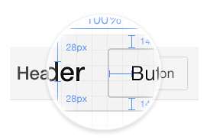
Beautifully designed
Clean, simple, and functional.
Ionic has been designed to work and display beautifully on
all current mobile devices and platforms.
With ready-made mobile components, typography,
and a gorgeous (yet extensible) base theme that adapts to each platform,
you'll be building in style.

Slide 8
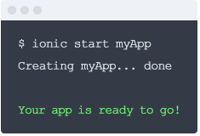
A powerful CLI
Use just one command to create, build, test, and
deploy your Ionic apps onto any platform.
With amazing features like Live Reload and integrated logging,
you'll already be miles ahead of your native frenemies.
Just run npm install -g ionic, and you're good to go!

Slide 9
Tools for ionic
First, install Node.js. Then, install the latest Cordova and Ionic command-line tools. Follow the Android and iOS platform guides to install required platform dependencies.
Any Text Editor Can will Accept Like VS Code, Sublime, Atom, Eclipse, Notepad
I am using VS Code, you can use any text Editor.
Htpp://www.ionicframework.com/getting-started/index.html.

Slide 10
Install ionic
$ npm install -g cordova ionic

Slide 11
Let’s Start

